Slide 1


Spark SQL: Relational Data Processing in Spark
Michael Armbrust, Reynold Xin, Cheng Lian, Yin Huai,
Davies Liu, Joseph K. Bradley, Xiangrui Meng, Tomer Kaftan, Michael J. Franklin, Ali Ghodsi, Matei Zaharia
SIGMOD 2015 – Melbourne, Australia
Presented by Doris Xin
Based on slides provided by M. Armbrust

Slide 2
Challenges and Solutions
Challenges
Solutions
Perform ETL to and from various (semi- or unstructured) data sources
Perform advanced analytics (e.g. machine learning, graph processing) that are hard to express in relational systems.
A DataFrame API that can perform relational operations on both external data sources and Spark’s built-in RDDs.
A highly extensible optimizer, Catalyst, that uses features of Scala to add composable rule, control code gen., and define extensions.

Slide 3
What is Apache Spark?
Fast and general cluster computing system, interoperable with Hadoop, included in all major distros
Improves efficiency through:
In-memory computing primitives
General computation graphs
Improves usability through:
Rich APIs in Scala, Java, Python
Interactive shell
Up to 100× faster
(2-10× on disk)
2-5× less code

Slide 4
Spark Model
Write programs in terms of transformations on distributed datasets
Resilient Distributed Datasets (RDDs)
Collections of objects that can be stored in memory or disk across a cluster
Parallel functional transformations (map, filter, …)
Automatically rebuilt on failure

Slide 5


On-Disk Sort Record: Time to sort 100TB
2013 Record: Hadoop
2100 machines
72 minutes
2014 Record: Spark
207 machines
23 minutes
Also sorted 1PB in 4 hours
Source: Daytona GraySort benchmark, sortbenchmark.org

Slide 6
Powerful Stack – Agile Development
non-test, non-example source lines

Slide 7
Powerful Stack – Agile Development
Streaming
non-test, non-example source lines

Slide 8
Powerful Stack – Agile Development
SparkSQL
Streaming
non-test, non-example source lines

Slide 9
Powerful Stack – Agile Development
GraphX
SparkSQL
Streaming
non-test, non-example source lines

Slide 10
Powerful Stack – Agile Development
Your fancy
SIGMOD technique
here
GraphX
SparkSQL
Streaming
non-test, non-example source lines

Slide 11

About
SQL
Spark SQL
Part of the core distribution since Spark 1.0 (April 2014)

Slide 12

About
SQL
Spark SQL
Part of the core distribution since Spark 1.0 (April 2014)
Runs SQL / HiveQL queries, optionally alongside or replacing existing Hive deployments
SELECT COUNT(*)
FROM hiveTable
WHERE hive_udf(data)

Slide 13

Improvement upon Existing Art
Engine does not understand the structure of the data in RDDs or the semantics of user functions → limited optimization.
Can only be used to query external data in Hive catalog → limited data sources
Can only be invoked via SQL string from Spark→ error prone
Hive optimizer tailored for MapReduce → difficult to extend

Slide 14
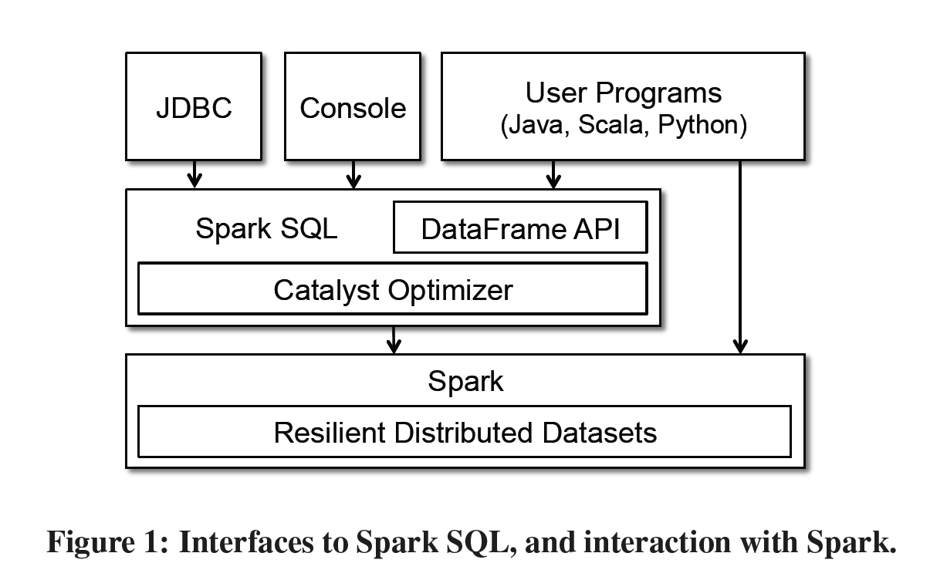
Programming Interface

Slide 15
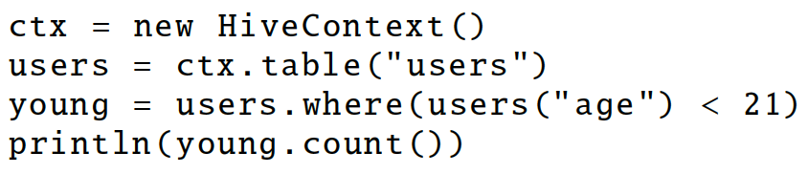
DataFrame
A distributed collection of rows with the same schema (RDDs suffer from type erasure)
Can be constructed from external data sources or RDDs into essentially an RDD of Row objects (SchemaRDDs as of Spark < 1.3)
Supports relational operators (e.g. where, groupby) as well as Spark operations.
Evaluated lazily → unmaterialized logical plan

Slide 16
Data Model
Nested data model
Supports both primitive SQL types (boolean, integer, double, decimal, string, data, timestamp) and complex types (structs, arrays, maps, and unions); also user defined types.
First class support for complex data types

Slide 17
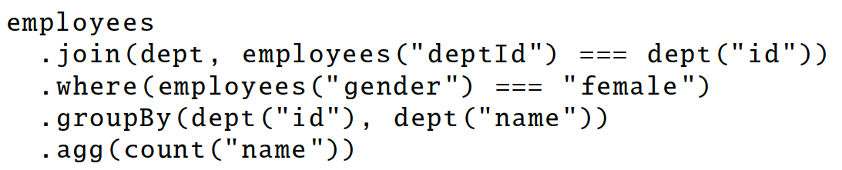
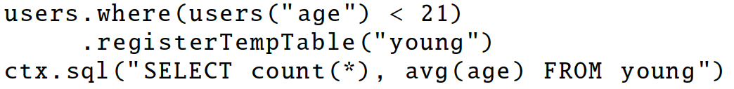
DataFrame Operations
Relational operations (select, where, join, groupBy) via a DSL
Operators take expression objects
Operators build up an abstract syntax tree (AST), which is then optimized by Catalyst.
Alternatively, register as temp SQL table and perform traditional SQL query strings
Notes:
traditional sql convenient for computing multiple things at the same time

Slide 18
Advantages over Relational Query Languages
Holistic optimization across functions composed in different languages.
Control structures (e.g. if, for)
Logical plan analyzed eagerly → identify code errors associated with data schema issues on the fly.

Slide 19
Querying Native Datasets
Infer column names and types directly from data objects (via reflection in Java and Scala and data sampling in Python, which is dynamically typed)
Native objects accessed in-place to avoid expensive data format transformation.
Benefits:
Run relational operations on existing Spark programs.
Combine RDDs with external structured data
Columnar storage with hot columns cached in memory

Slide 20
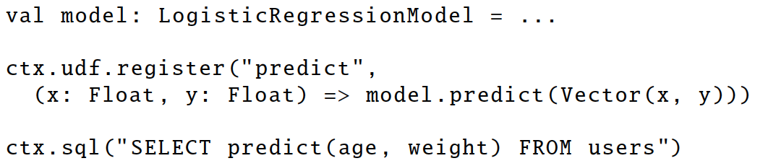
User-Defined Functions (UDFs)
Easy extension of limited operations supported.
Allows inline registration of UDFs
Compare with Pig, which requires the UDF to be written in a Java package that’s loaded into the Pig script.
Can be defined on simple data types or entire tables.
UDFs available to other interfaces after registration

Slide 21
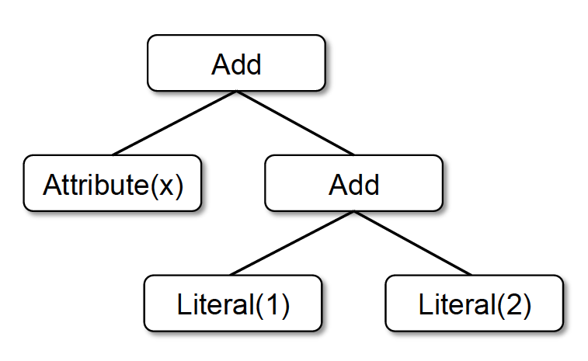
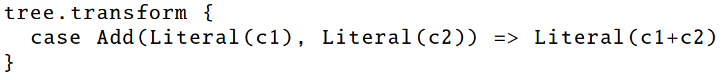
Catalyst
Add
Attribute(x)
Literal(3)
x + (1 + 2)
x + 3
Notes:
Done in Scala because functional programming languages naturally support compiler functions.

Slide 22
Prior Work: Optimizer Generators
Volcano / Cascades:
Create a custom language for expressing rules that rewrite trees of relational operators.
Build a compiler that generates executable code for these rules.
Cons: Developers need to learn this custom language. Language might not be powerful enough.

Slide 23
Catalyst Rules
Pattern matching functions that transform subtrees into specific structures.
Partial function—skip over subtrees that do not match → no need to modify existing rules when adding new types of operators.
Multiple patterns in the same transform call.
May take multiple batches to reach a fixed point.
transform can contain arbitrary Scala code.

Slide 24
Plan Optimization & Execution
Logical
Optimization
Physical
Planning
Code
Generation
Analysis
SQL AST
Unresolved Logical Plan
Logical Plan
Optimized Logical Plan
Physical Plans
Selected Physical Plan
RDDs
Cost Model
DataFrame
Catalog
DataFrames and SQL share the same optimization/execution pipeline

Slide 25
Plan Optimization & Execution
Logical
Optimization
Physical
Planning
Code
Generation
Analysis
SQL AST
Unresolved Logical Plan
Logical Plan
Optimized Logical Plan
Physical Plans
Selected Physical Plan
RDDs
Cost Model
DataFrame
Catalog
DataFrames and SQL share the same optimization/execution pipeline

Slide 26
An attribute is unresolved if its type is not known or it’s not matched to an input table.
To resolve attributes:
Look up relations by name from the catalog.
Map named attributes to the input provided given operator’s children.
UID for references to the same value
Propagate and coerce types through expressions (e.g. 1 + col)
Analysis
Unresolved Logical Plan
Logical Plan
Catalog
SELECT col FROM sales

Slide 27
Plan Optimization & Execution
Logical
Optimization
Physical
Planning
Code
Generation
Analysis
SQL AST
Unresolved Logical Plan
Logical Plan
Optimized Logical Plan
Physical Plans
Selected Physical Plan
RDDs
Cost Model
DataFrame
Catalog
DataFrames and SQL share the same optimization/execution pipeline

Slide 28
Plan Optimization & Execution
Logical
Optimization
Physical
Planning
Code
Generation
Analysis
SQL AST
Unresolved Logical Plan
Logical Plan
Optimized Logical Plan
Physical Plans
Selected Physical Plan
RDDs
Cost Model
DataFrame
Catalog
DataFrames and SQL share the same optimization/execution pipeline

Slide 29
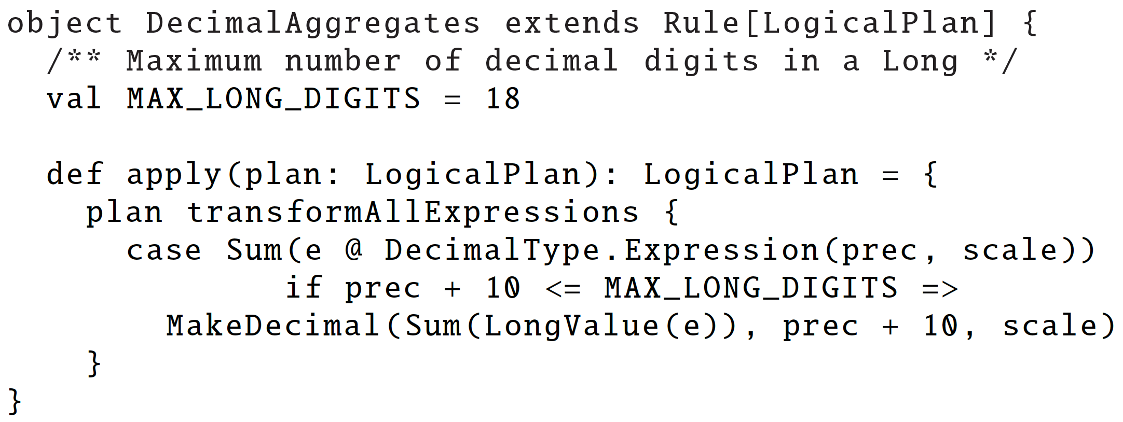
Applies standard rule-based optimization (constant folding, predicate-pushdown, projection pruning, null propagation, boolean expression simplification, etc)
800LOC
Logical
Optimization
Logical Plan
Optimized Logical Plan

Slide 30
Plan Optimization & Execution
Logical
Optimization
Physical
Planning
Code
Generation
Analysis
SQL AST
Unresolved Logical Plan
Logical Plan
Optimized Logical Plan
Physical Plans
Selected Physical Plan
RDDs
Cost Model
DataFrame
Catalog
DataFrames and SQL share the same optimization/execution pipeline

Slide 31
Plan Optimization & Execution
e.g. Pipeline projections and filters into a single map
Logical
Optimization
Physical
Planning
Code
Generation
Analysis
SQL AST
Unresolved Logical Plan
Logical Plan
Optimized Logical Plan
Physical Plans
Selected Physical Plan
RDDs
Cost Model
DataFrame
Catalog
DataFrames and SQL share the same optimization/execution pipeline

Slide 32
def add_demographics(events):
u = sqlCtx.table("users") # Load partitioned Hive table
events \
.join(u, events.user_id == u.user_id) \ # Join on user_id
.withColumn("city", zipToCity(df.zip)) # Run udf to add city column
events = add_demographics(sqlCtx.load("/data/events", "parquet"))
training_data = events.where(events.city == "Melbourne").select(events.timestamp).collect()
Physical Plan
Physical Plan
with Predicate Pushdown and Column Pruning
Logical Plan
filter
join
join
join
scan
(events)
filter
optimized
scan
(events)
optimized scan
(users)
events file
users table
scan
(users)

Slide 33
An Example Catalyst Transformation
Find filters on top of projections.
Check that the filter can be evaluated without the result of the project.
If so, switch the operators.

Slide 34
Plan Optimization & Execution
Logical
Optimization
Physical
Planning
Code
Generation
Analysis
SQL AST
Unresolved Logical Plan
Logical Plan
Optimized Logical Plan
Physical Plans
Selected Physical Plan
RDDs
Cost Model
DataFrame
Catalog
DataFrames and SQL share the same optimization/execution pipeline

Slide 35
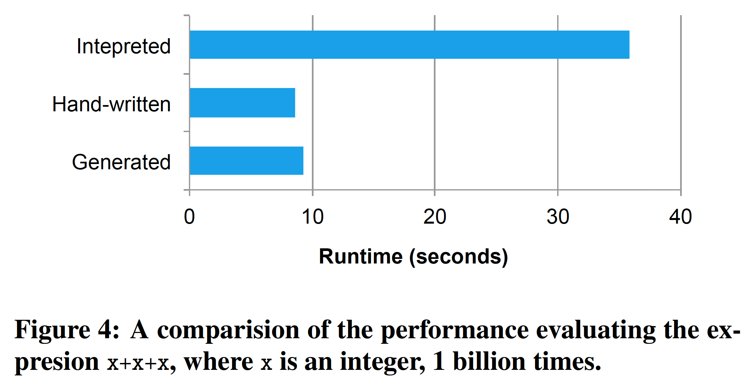
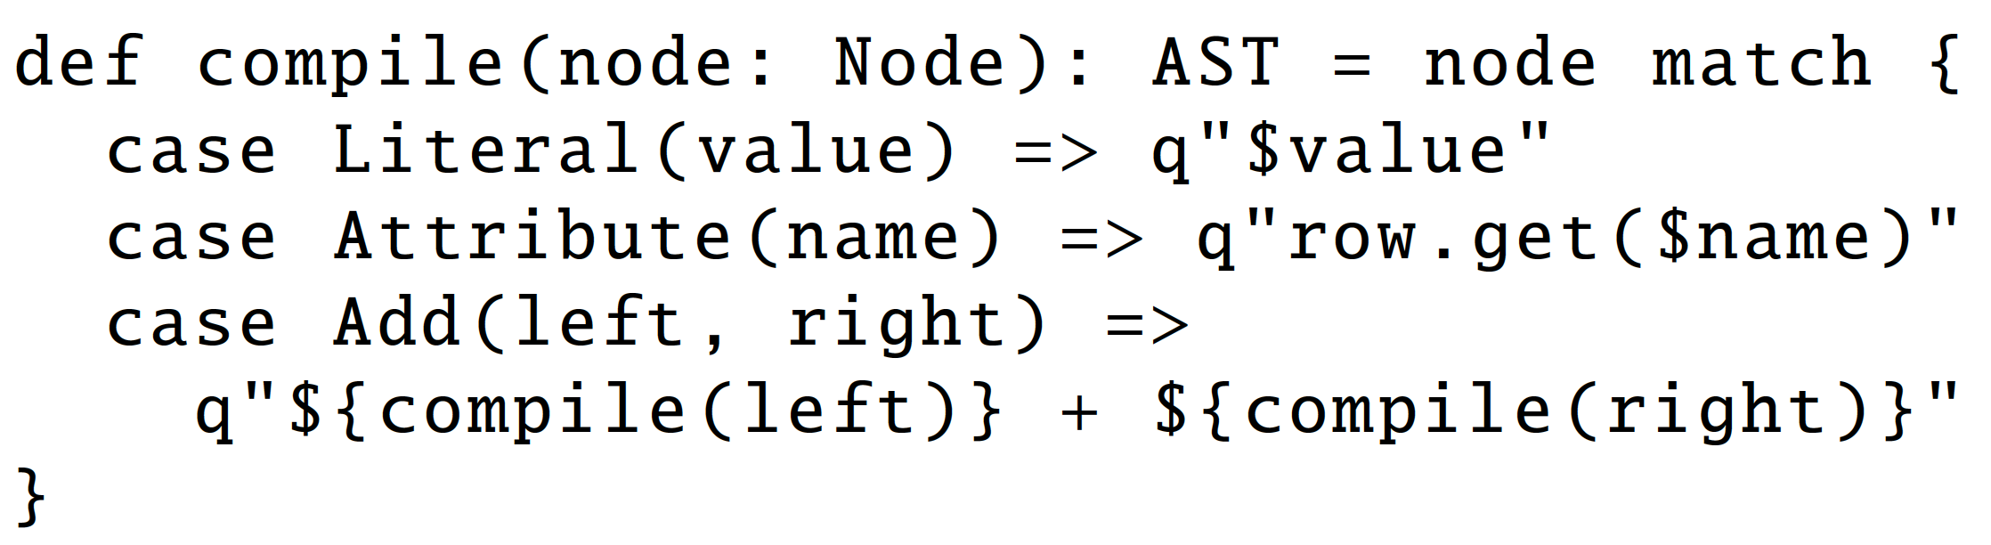
Code Generation
Relies on Scala’s quasiquotes to simplify code gen.
Catalyst transforms a SQL tree into an abstract syntax tree (AST) for Scala code to eval expr and generate code
700LOC

Slide 36
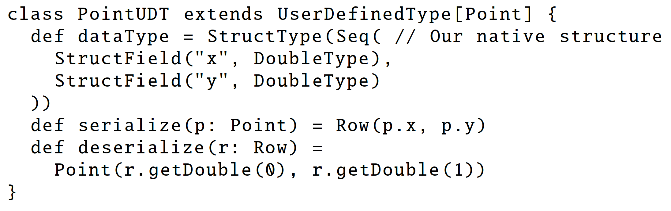
Extensions
Data Sources
must implement a createRelation function that takes a set of key-value params and returns a BaseRelation object.
E.g. CSV, Avro, Parquet, JDBC
User-Defined Types (UDTs)
Map user-defined types to structures composed of Catalyst’s built-in types.

Slide 37
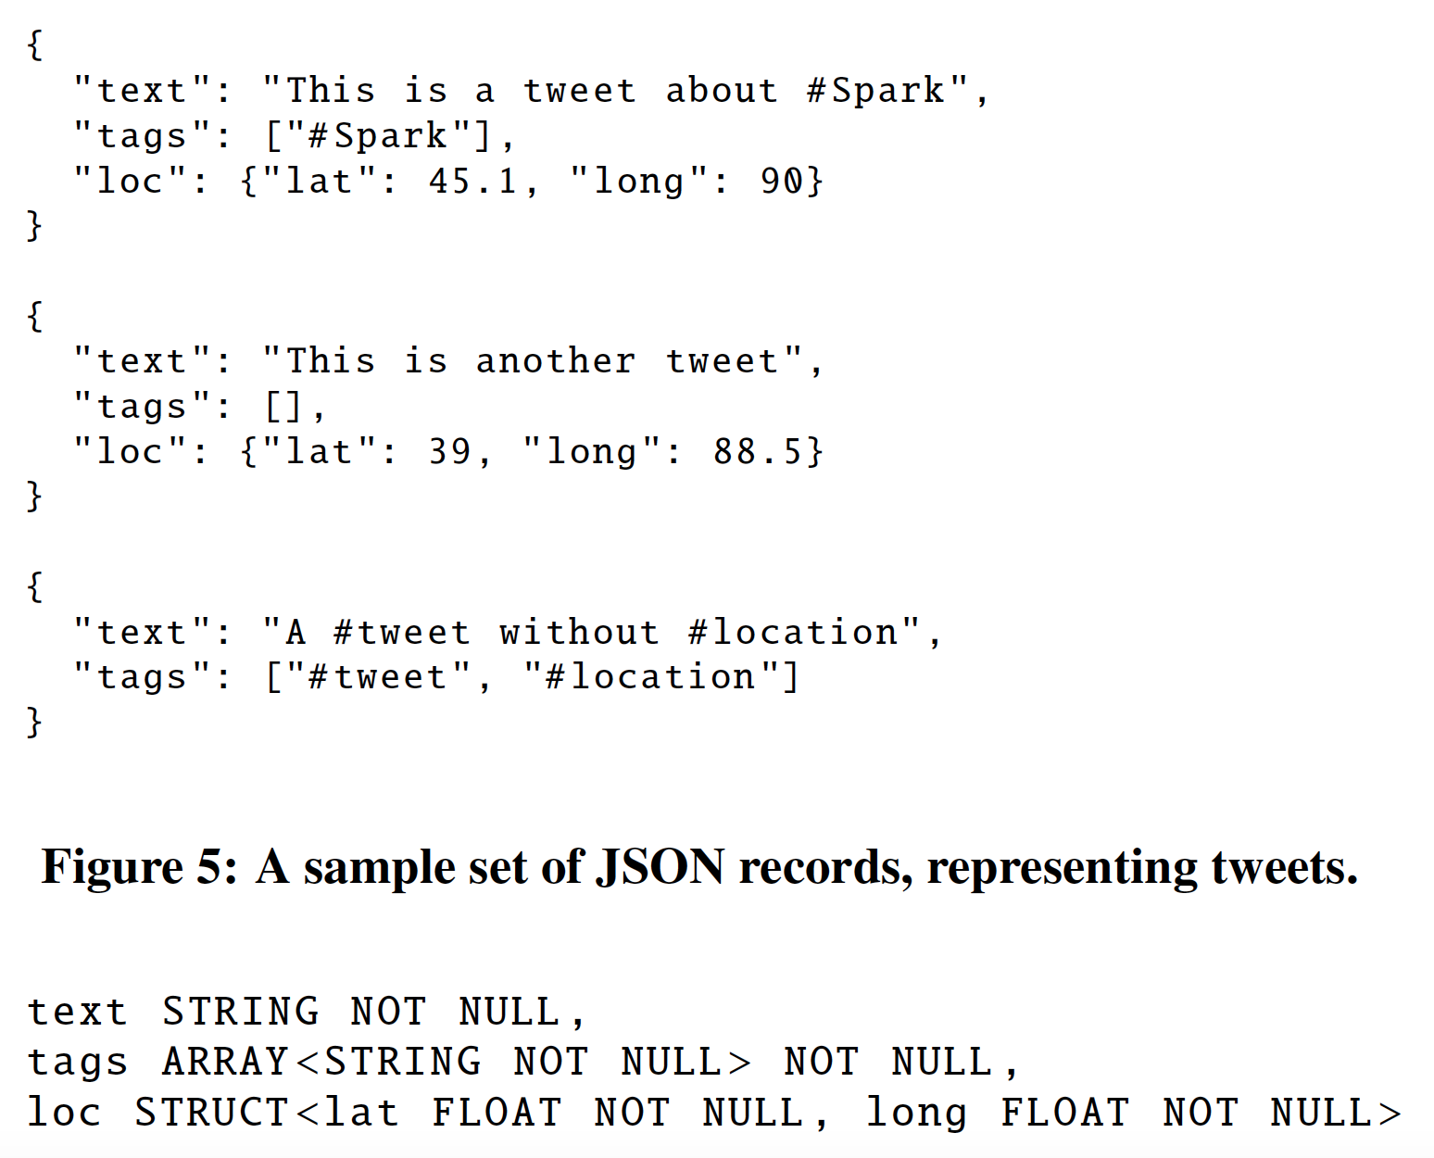
Advanced Analytics Features Schema Inference for Semistructured Data
JSON
Automatically infers schema from a set of records, in one pass or sample
A tree of STRUCT types, each of which may contain atoms, arrays, or other STRUCTs.
Find the most appropriate type for a field based on all data observed in that column. Determine array element types in the same way.
Merge schemata of single records in one reduce operation.
Same trick for Python typing

Slide 38
Spark MLlib Pipelines
tokenizer = Tokenizer(inputCol="text", outputCol="words”)
hashingTF = HashingTF(inputCol="words", outputCol="features”)
lr = LogisticRegression(maxIter=10, regParam=0.01)
pipeline = Pipeline(stages=[tokenizer, hashingTF, lr])
df = sqlCtx.load("/path/to/data")
model = pipeline.fit(df)
lr
ds0
ds1
ds2
ds3
tokenizer
hashingTF
lr.model
Pipeline Model

Slide 39
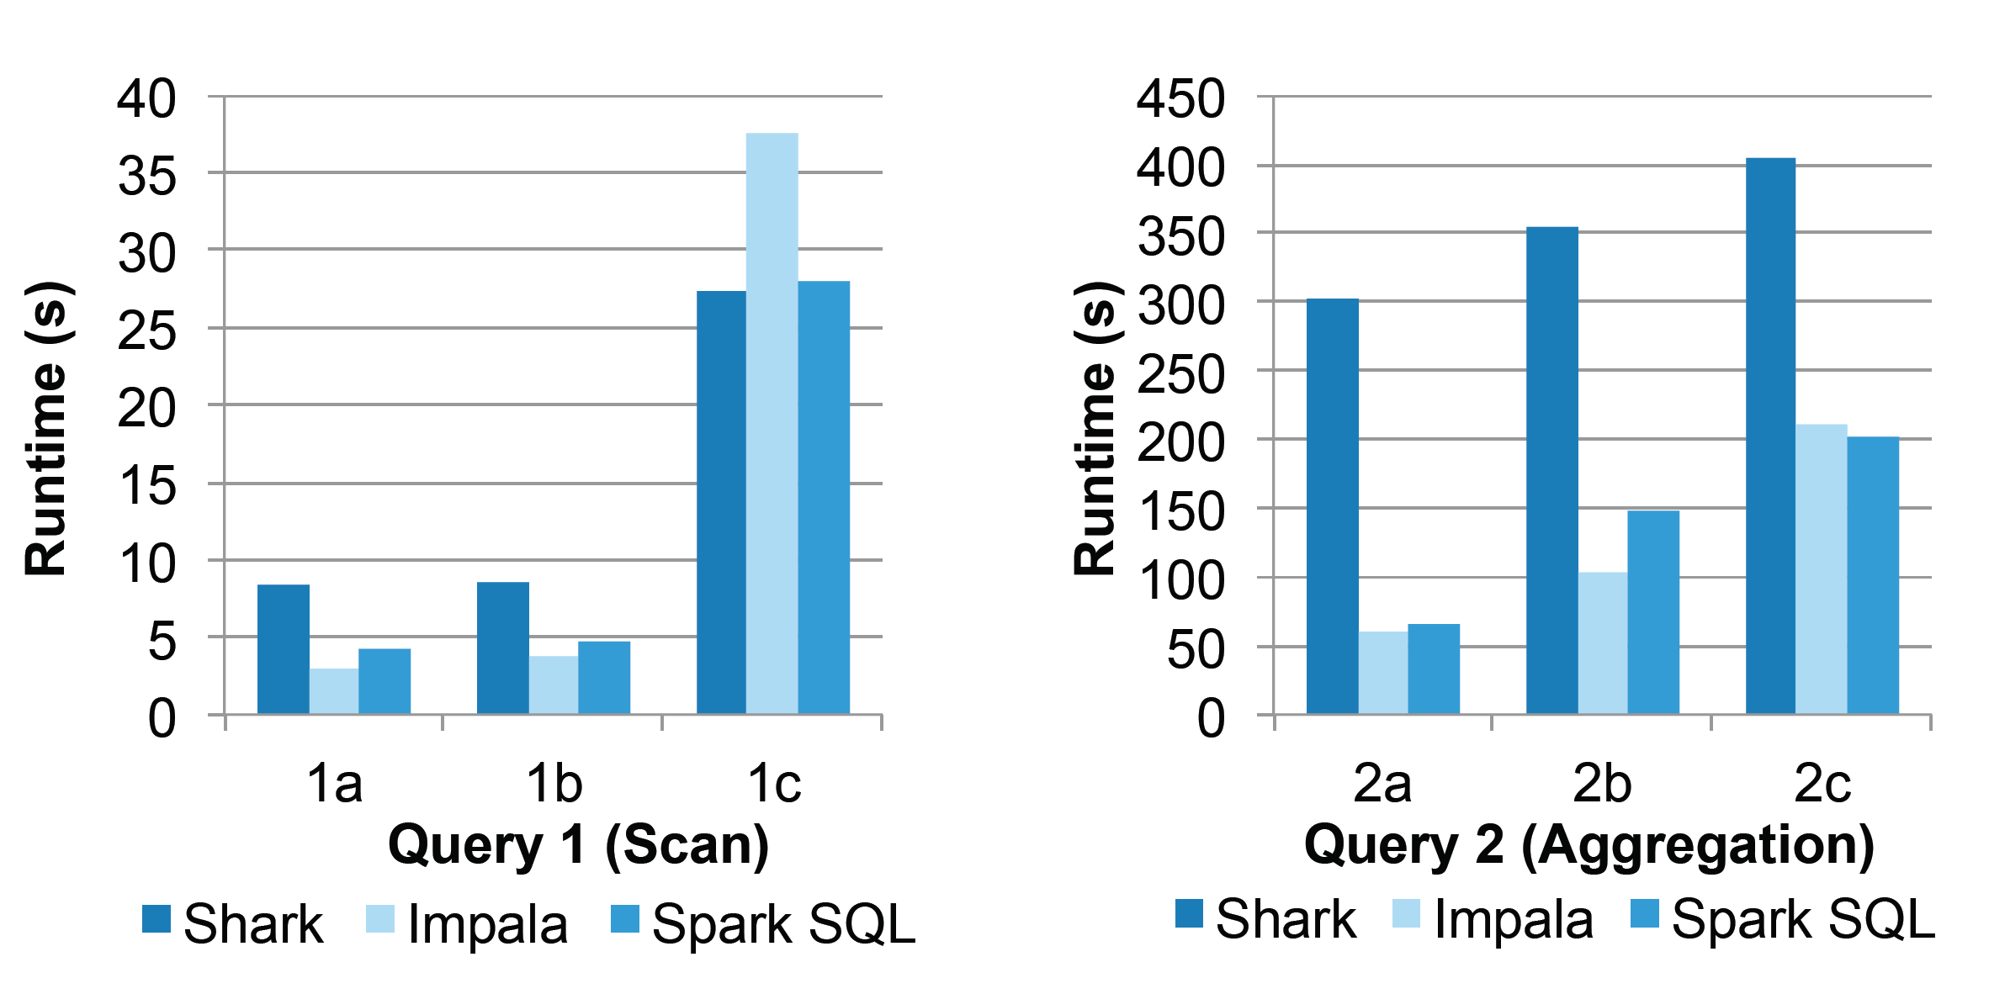
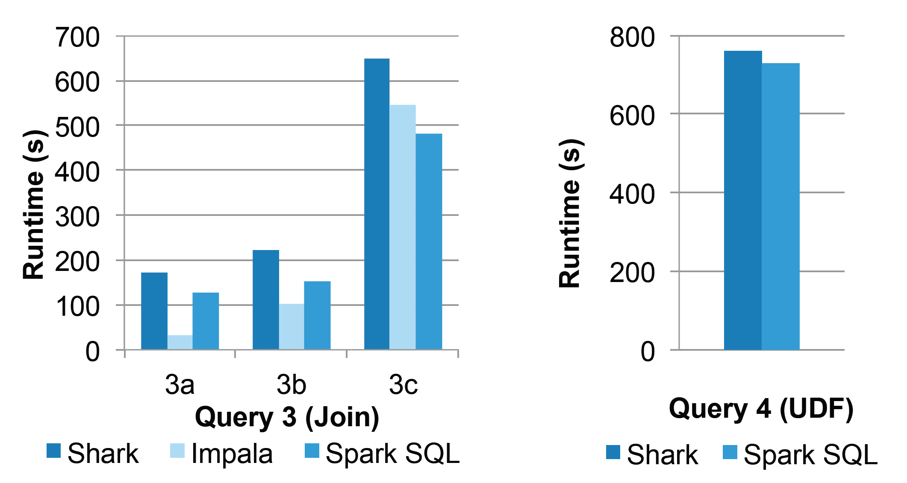
110GB of data
after columnar
compression
with Parquet

Slide 40
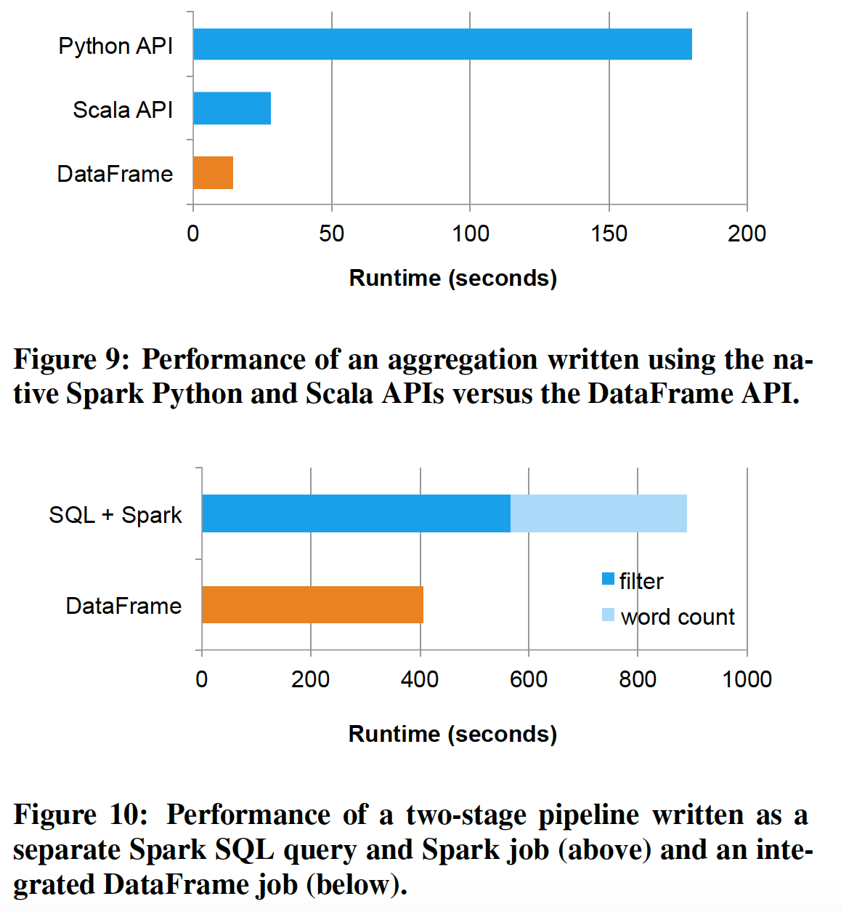

Slide 41
Research Transformations: Generalized Online Aggregation
Running State of Deterministic Tuples
AGGR
AGGR
AVG(latency)
AVG(latency)
FILTER
Uncertain Tuples
FILTER
latency > AVG(latency)
latency > AVG(latency)
JOIN
JOIN
AGGR
SCAN
AGGR
SCAN
AVG(latency)
AVG(latency)
SCAN
SCAN
Running State

Slide 42
Full Prototype:
3000 lines of code
AGGR
AVG(latency)
Union
Running State of Deterministic Tuples
AGGR
AVG(latency)
FILTER
latency > AVG(latency)
FILTER
Uncertain Tuples
latency > AVG(latency)
Union
JOIN
JOIN
AGGR
SCAN
AGGR
SCAN
AVG(latency)
AVG(latency)
Union
SIGMOD
Demo A
SCAN
Running State
SCAN

Slide 43

Research Transformation: Genomics
Recognize range joins and use interval trees.
SELECT * FROM a JOIN b
WHERE a.start < a.end
AND b.start < b.end
AND a.start < b.start
AND b.start < a.end

Slide 44
Future Work: Project Tungsten
Overcome JVM limitations:
Memory Management and Binary Processing: leveraging application semantics to manage memory explicitly and eliminate the overhead of JVM object model and garbage collection
Cache-aware computation: algorithms and data structures to exploit memory hierarchy
Code generation: using code generation to exploit modern compilers and CPUs

Slide 45
Questions?

Slide 48
The not-so-secret truth...
SQL
is about more than SQL.

Slide 49
: Declarative BigData Processing
SQL
Let Developers Create and Run Spark Programs Faster:
Write less code
Read less data
Let the optimizer do the hard work

Slide 50
DataFrame
noun – [dey-tuh-freym]
A distributed collection of rows organized into named columns.
An abstraction for selecting, filtering, aggregating and plotting structured data (cf. R, Pandas).
Archaic: Previously SchemaRDD (cf. Spark < 1.3).

Slide 51

Write Less Code: Compute an Average
private IntWritable one =
new IntWritable(1)
private IntWritable output =
new IntWritable()
proctected void map(
LongWritable key,
Text value,
Context context) {
String[] fields = value.split("\t")
output.set(Integer.parseInt(fields[1]))
context.write(one, output)
}
IntWritable one = new IntWritable(1)
DoubleWritable average = new DoubleWritable()
protected void reduce(
IntWritable key,
Iterable<IntWritable> values,
Context context) {
int sum = 0
int count = 0
for(IntWritable value : values) {
sum += value.get()
count++
}
average.set(sum / (double) count)
context.Write(key, average)
}
data = sc.textFile(...).split("\t")
data.map(lambda x: (x[0], [x.[1], 1])) \
.reduceByKey(lambda x, y: [x[0] + y[0], x[1] + y[1]]) \
.map(lambda x: [x[0], x[1][0] / x[1][1]]) \
.collect()

Slide 52
Write Less Code: Compute an Average
Using RDDs
data = sc.textFile(...).split("\t")
data.map(lambda x: (x[0], [int(x[1]), 1])) \
.reduceByKey(lambda x, y: [x[0] + y[0], x[1] + y[1]]) \
.map(lambda x: [x[0], x[1][0] / x[1][1]]) \
.collect()
Using SQL
SELECT name, avg(age)
FROM people
GROUP BY name
Using Pig
P = load '/people' as (name, name);
G = group P by name;
R = foreach G generate … AVG(G.age);
Using DataFrames
sqlCtx.table("people") \
.groupBy("name") \
.agg("name", avg("age")) \
.collect()

Slide 53
Seamlessly Integrated: RDDs
Internally, DataFrame execution is done with Spark RDDs making interoperation with outside sources and custom algorithms easy.
External Input
def buildScan(
requiredColumns: Array[String],
filters: Array[Filter]): RDD[Row]
Custom Processing
queryResult.rdd.mapPartitions { iter =>
… Your code here …
}

Slide 54
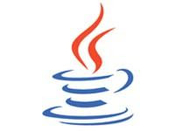





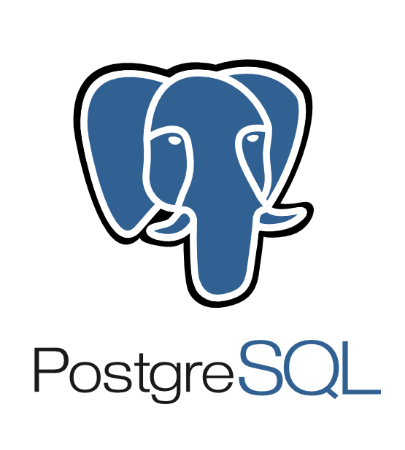









Extensible Input & Output
Spark’s Data Source API allows optimizations like column pruning and filter pushdown into custom data sources.
Built-In
External
{ JSON }
JDBC
and more…

Slide 55
Seamlessly Integrated
Embedding in a full programming language makes UDFs trivial and allows composition using functions.
zipToCity = udf(lambda city: <custom logic here>)
def add_demographics(events):
u = sqlCtx.table("users")
events \
.join(u, events.user_id == u.user_id) \
.withColumn("city", zipToCity(df.zip))
Takes and returns a DataFrame

Slide 56
Spark MLlib Pipelines
tokenizer = Tokenizer(inputCol="text", outputCol="words”)
hashingTF = HashingTF(inputCol="words", outputCol="features”)
lr = LogisticRegression(maxIter=10, regParam=0.01)
pipeline = Pipeline(stages=[tokenizer, hashingTF, lr])
df = sqlCtx.load("/path/to/data")
model = pipeline.fit(df)
lr
ds0
ds1
ds2
ds3
tokenizer
hashingTF
lr.model
Pipeline Model

